Slide 1



BUSINESS ANALYTICS AND DECISION-MAKING PROJECT
DESCRIPTIVE ANALYSIS ON IMPACT OF UNEMPLOYMENT IN INDIA
DAB – 203 Project
SECTION - 002

Slide 2

Aashutosh Sehgal (0780170)
Rahul Challa (0782086)
Preet Kamal Kaur (0779220)
Noorjahan Shaik (0780817)
Team Members

Slide 3

Motivation
Unemployment is a social threat that India has been facing as a developing nation.
Joblessness in the country makes headlines almost all the time along with assumptions and estimates of it’s causes and consequences.
However, it remains pivotal to understand what the situation looks like for real at the basic level and from different perspectives.
As per Wikipedia, Unemployment or joblessness is when a person who is of normal working age(usually about 15-18 to about 60-65) does not have a paid job. They therefore do not get paid a salary.

Slide 4
As a part of our problem statement, we’d be trying to understand the following in context of unemployment :-
Suicide victims' classification by their age group and professional profile.
Unemployed people as per the categories they belong to.
Suicide trend in India as per the educational qualification of victims.
Poverty situation of Indian states and Union Territories.
Note – These social problems would be studied in relation to unemployment for India. The exact analysis question to be addressed from the data are mentioned in slides 7 and 8.

Slide 5
Project Objective
The idea is to analyze the number of non workers in all states of India as per the 2011 Census for deriving solid and useful insights to answer a set of research questions.
Relating the unemployment rate with educational qualification of people , their social status, gender, poverty statistics and suicide rate in India is the motive of this project work.

Slide 6

What is being used
SQL – To gather subsets of data which are considered as useful to draw insights and to perform analysis.
Tkinter package from python - To make a Graphical User Interface (GUI) to have a window ready for users to interact and understand the analysis being performed.
Matplotlib – For visualizing the insights in the form of Charts and graphs.

Slide 7

Research Questions
1. Which Indian state does unemployment has the worst impact on ? Do a specific educational category of non-workers contribute heavily to the same ?
2. Who among unemployed men/women are more suicidal ? Which age group committed the most suicides ? How do these numbers compare to classification of victims by their age group ?

Slide 8
Research questions (contd.)
3. The Number of people as a different categories who are contributing towards unemployment state wise in India ?
4. How strongly does poverty of our nation driven by unemployment ? What kind of exact relationship does the two social problems have ?

Slide 9

Datasets to be used in the project

Slide 10
Census 2011 Data
Source : https://data.gov.in
Dataset Link: https://data.gov.in/resources/non-workers-main-activity-age-and-sex-2011-india
Brief Introduction - We are going to use the census data set which contains the overall list of all the people categorized into various occupations for 7 different educational levels for all the states of India recorded over the period 2001-2011

Slide 11
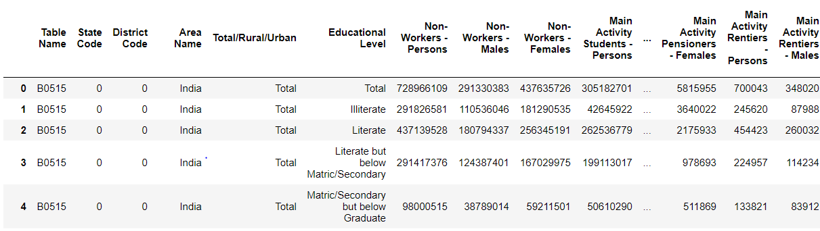
Basic overview of the Dataset
Fig.1 represents the first 4 observations of the data for different educational levels and Count of different occupations for all the states.

Slide 12
Poverty line data
Source :https://niti.gov.in
Dataset Link: https://niti.gov.in/sites/default/files/2020-05/press-note-poverty-2011-12-23-08-16.pdf
The poverty line dataset contains the data about the percentage of people and the No. of people in Lakhs below the poverty line for all the states respectively during years 2011 and 2012.

Slide 13
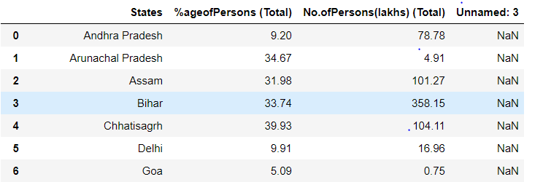
Basic overview of the data set
Fig. 2 The first few rows of the dataset and the % of people and No. of people columns are represented for each state.

Slide 14
Educational qualification of suicide victim's data
Dataset Source :-
https://data.gov.in
Dataset Link :-
https://data.gov.in/resources/stateut-wise-educational-status-suicide-victim-during-2001-2012
Brief Introduction :-
The census 2011 data will be the primary dataset throughout the project work, but this data would be used in conjunction with the unemployment data for reaching on meaningful conclusions.
The dataset includes count of suicide victims belonging to different educational backgrounds classified by gender. It contains data for 35 Indian regions (including states and Union Territories) from 2001 to 2012.

Slide 15
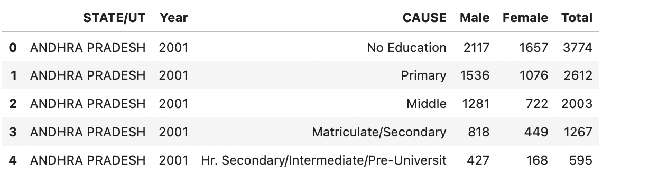
Initial look and feel of the data
Fig. 3 This is what the first few rows of the dataset looks like

Slide 16
Professional profile of suicide victims data
Dataset Link :- https://data.gov.in/
Dataset Source :- https://data.gov.in/resources/stateut-wise-educational-status-suicide-victim-during-2001-2012
Brief introduction :- This dataset would be used along with the previous one to have combined information about education as well as profession of the suicide victims.
The dataset includes count of suicide victims working in different sectors classified by gender as well age group . It contains data for 35 Indian regions from 2001 to 2012.

Slide 17
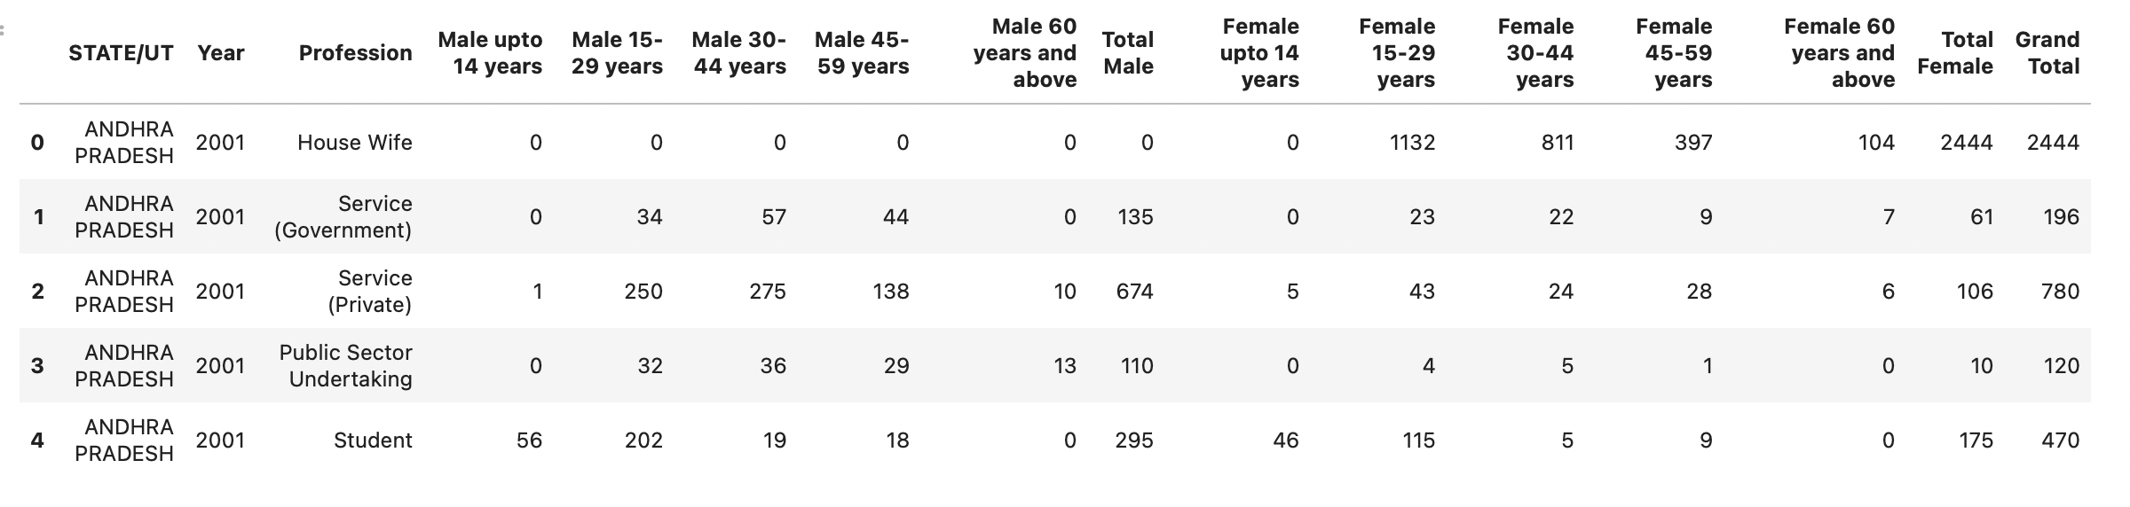
Overview of data
Count for Males
Count for Females
Fig. 4 The above snapshot shows the first 5 out of the 6840 entries of suicide victims all across the country
as per their profession and the age group they belong to.

Slide 18
Data cleaning and transformation
We had four datasets to be used in order to address our analysis questions.
Census data 2011
Poverty line data
Educational qualification of suicide victims' data
Professional profile of suicide victims' data
The upcoming slides would list the data cleaning and transformation tasks performed for each of these datasets one by one.

Slide 19
Data cleaning – Census 2011 data
Firstly, observing the Census Data, we found out that the data is structured and very clean with no Missing or Null values.
There were two columns named State code and District Code which are of no use for our analysis and hence were dropped.
The dimensions of the data initially was 864 rows and 30 columns showing the No of non workers belonging to different categories.
The no of rows was high because the data was divided for different states and had three groups, one for Total no and remaining two groups for Urban Areas in the state and thirdly Rural areas.
All the data cleaning steps have been performed in Ms Sql server

Slide 20
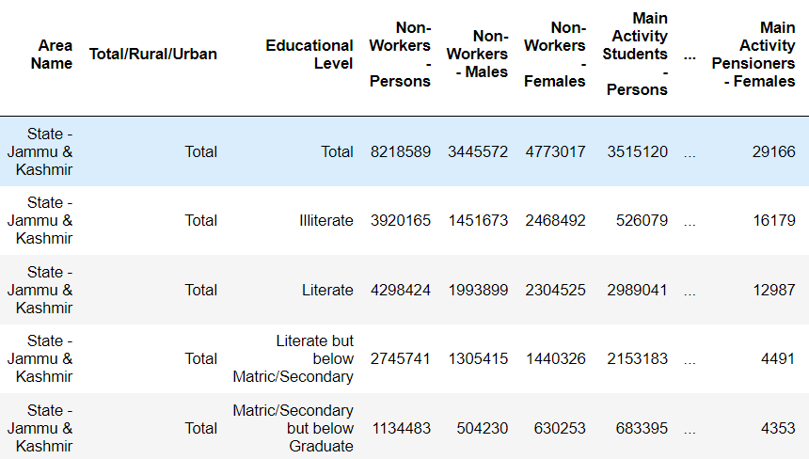
Data transformation – Census data 2011
We filtered the data for all the states which had the total count and dropped the rows showing values for Urban and Rural areas
The next step was to drop the rows where the values were given for entire country, i.e where the Area name is India.
Still we had 280 rows because of the different categories of educational Level.
Fig. 5 Census data pre-transformation

Slide 21
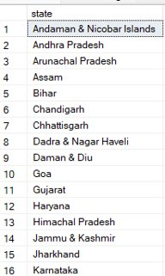
Data transformation – Census data 2011
After that the Area Name column had “State –” mentioned before each value of observation which had to be removed. For which we had used the Substring function in Sql and altered the rows ​
Fig. 6
Fig. 7

Slide 22
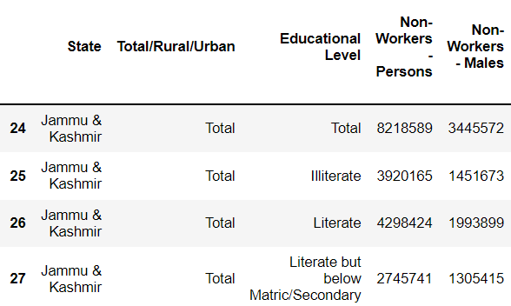
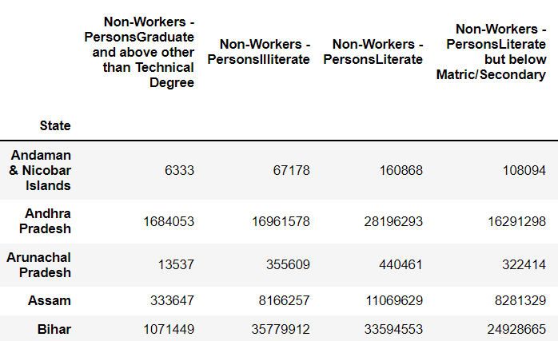
Data transformation – Census data 2011
Next the educational Level which had different categories of Education in rows has been transformed to get those categories in columns.
And the final data for census was saved.
This step was performed in Python.
Fig. 8
Fig. 9

Slide 23
Data cleaning – Poverty line data
Even the Poverty Line data set had data in a structured way with 3 columns and 35 rows representing observations for each state.
There were no missing values or Null values which had to be cleaned.
This data sat was ready to be merged with the Census dataset.

Slide 24
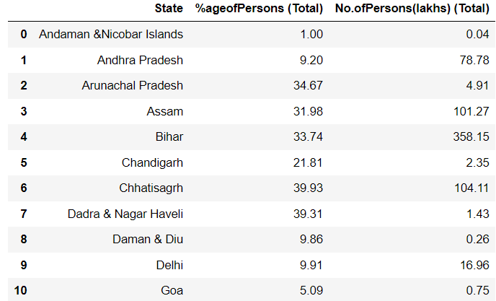
Data transformation – Poverty line data
No major transformations were made to Poverty Data set since everything was already ready to use.
The only change done was the State column which has different state values were of different formatting than census Dataset states. Hence the states column in Poverty data has been compared with Census Dataset State column and replaced.
Fig. 10

Slide 25
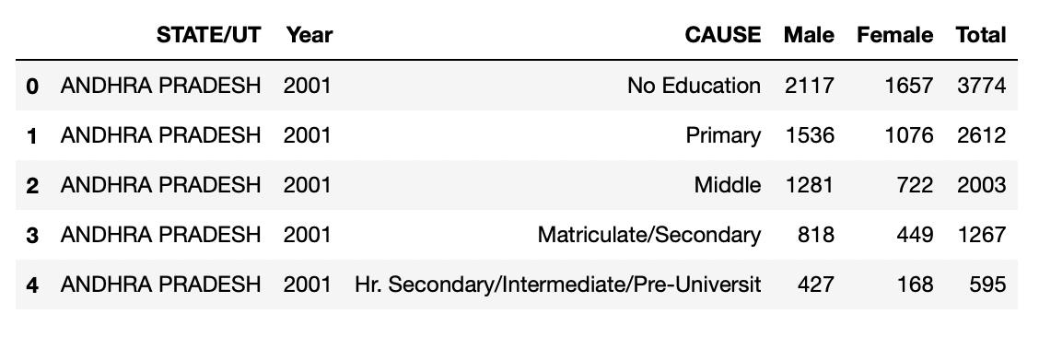
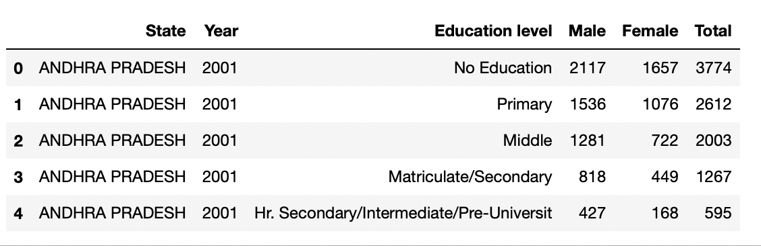
Data cleaning –Educational profile of suicide victims data
Fig. 11
Fig. 12
Task 1 – The names of the first and the third column were misleading, so we renamed them to suit the data as ”State” and “Education Level” respectively.

Slide 26
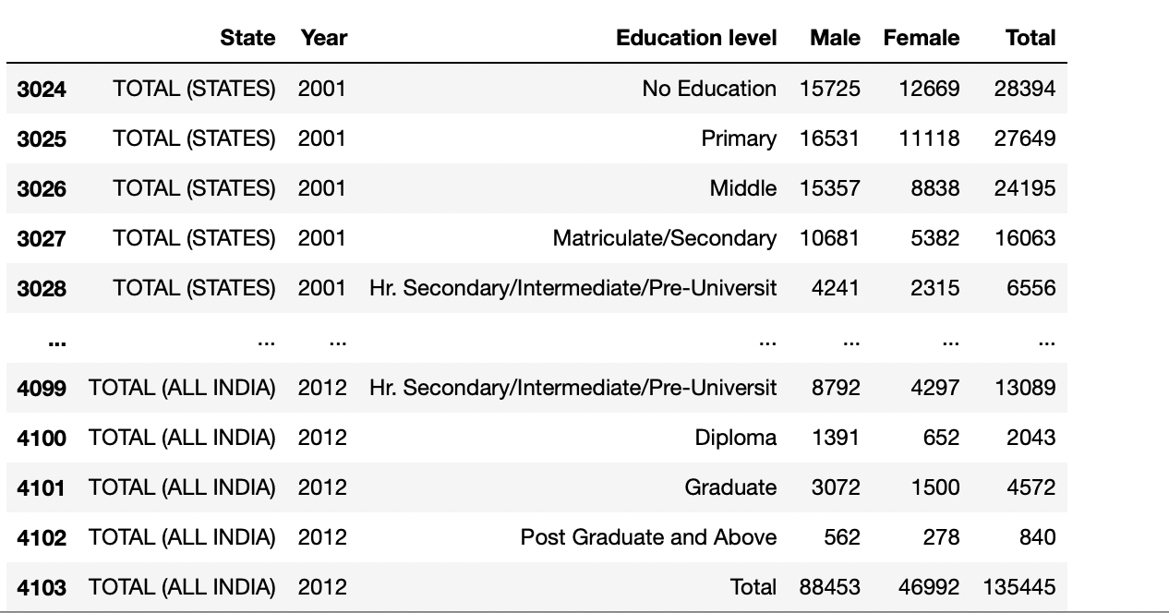
Data cleaning –Educational profile of suicide victims' data (contd.)
There were some unnecessary rows at the end of the data, typically representing the suicide count for the entire nation, for all states, for all of the union territories.
These however were not going to serve a purpose at all, so we removed them.
Task 2 These are the rows that were removed
Fig. 13

Slide 27
Data transformation –Educational profile of suicide victims' data
The following tasks were performed to make the data suitable for analysis :-
We were only interested to look at the suicide numbers for the year 2011, so data was filtered to remove all other years (2001-2010 and 2012).
“Total” was not meant to be an education category, it was removed as well.
The data had to be made suitable to be added up to our primary dataset i.e. Census 2011 data.
So, next step was to split up the education categories into columns, as the merging would be done as per the state.
There were multiple entries per Indian state (one for each education category), but we just wanted to have one row per state, hence the above mentioned transformation.

Slide 28
Data transformation –Educational profile of suicide victims data (contd.)
The education categories for the suicide data have been transformed to match up those present in census data. To illustrate, primary and middle education corresponded to a category named “Below matric/secondary” , so both of them were added up to ensure consistency.
The table above matches up education categories for suicide and Census data.
SUICIDE BY EDUCATION | CENSUS DATA
No Education | Illiterate
(Primary + Middle) | Below matric/secondary
(Matric/secondary + intermediate + diploma) | Matric/secondary but below graduate
Graduate + postgraduate and above | Graduate and above
Table 1

Slide 29
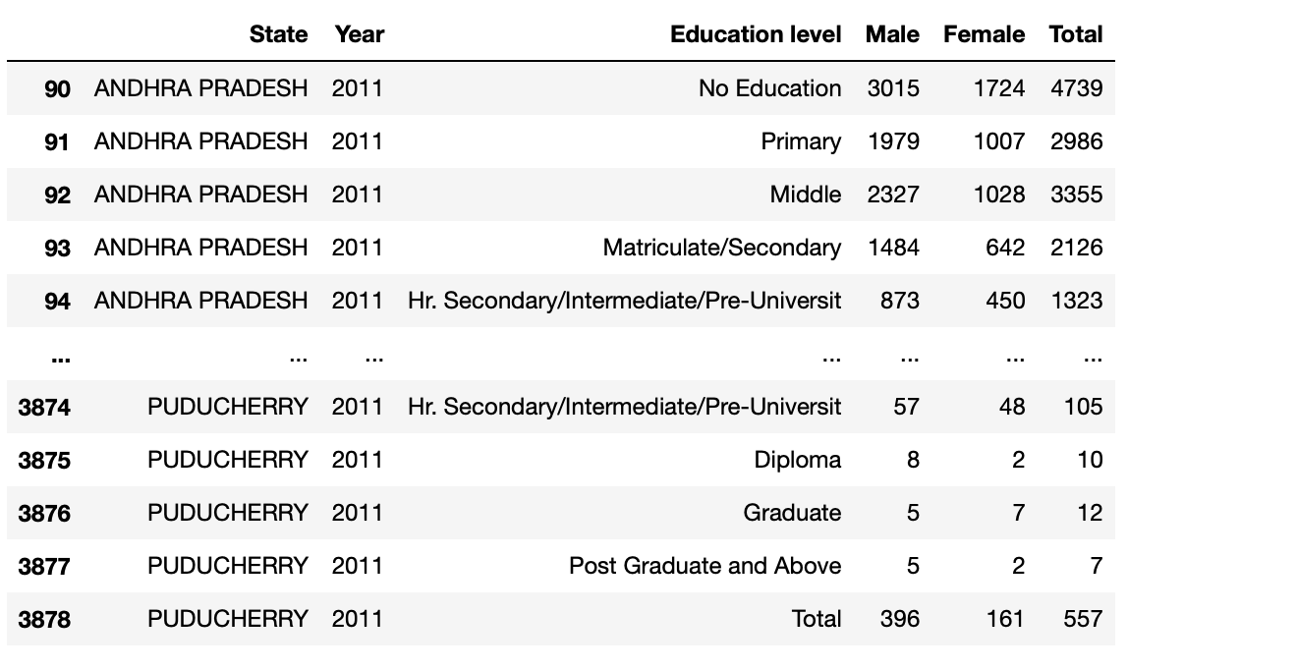
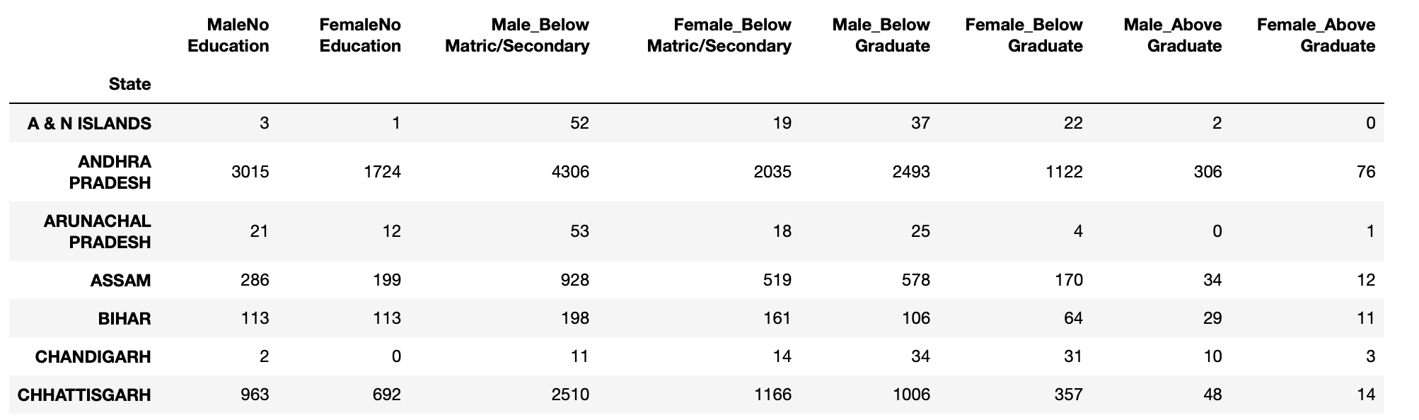
Data transformation –Educational profile of suicide victims data (contd.)
Fig. 15
Fig. 14
Before transformation (3780 X 6)
After transformation (35 X 8)

Slide 30
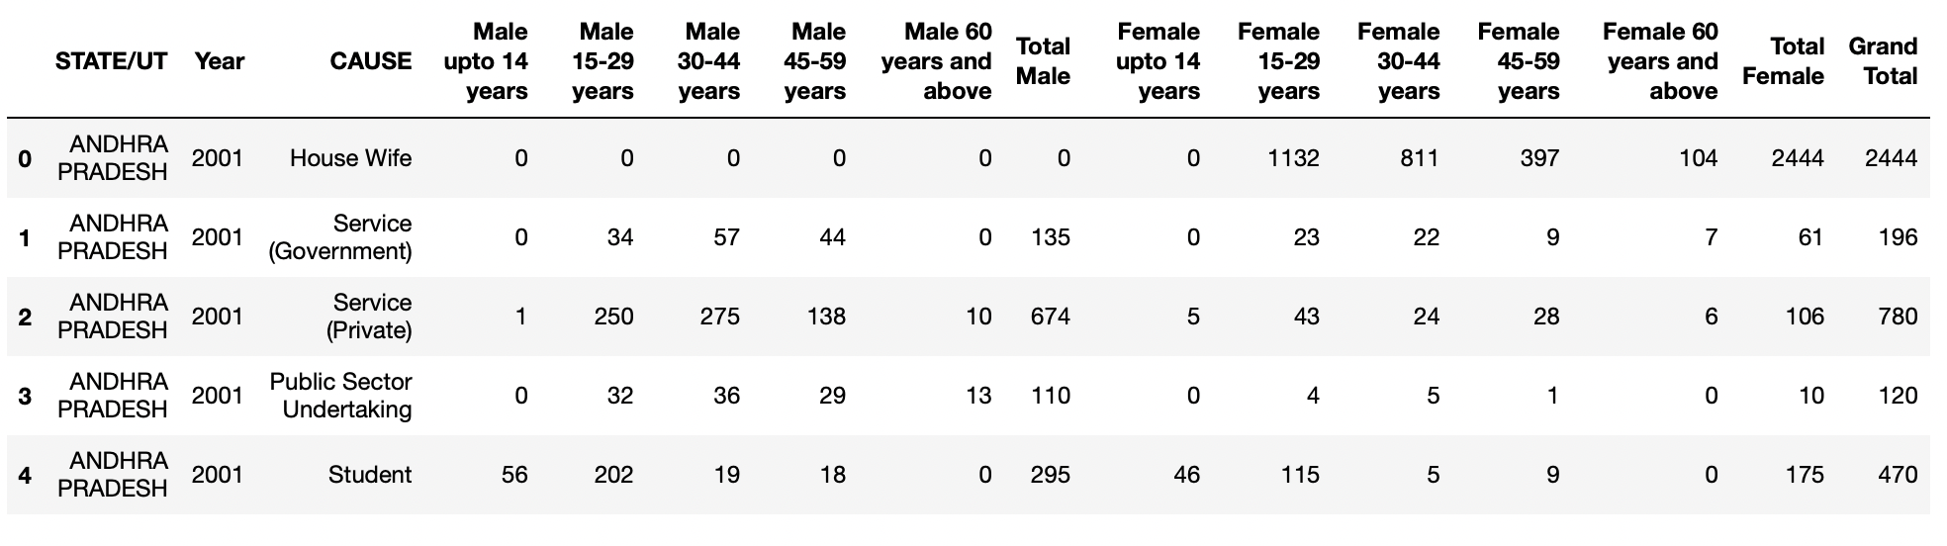
Data cleaning – Professional profile of suicide victims data
To begin with the ‘State/UT’ column was renamed to ‘State’.
Just like the previous data, the unnecessary rows representing total count for all states, union territories and the entire nation were removed.
The data was pretty much clean beyond that.
This is what we proceeded with for the transformation. The snippet shows the first few rows.
Fig. 16

Slide 31
Data transformation – Professional profile of suicide victims' data
The transformation steps given below were performed on the data:-
Since the year of interest is 2011, rows for rest of the years (2001 – 2010 and 2012) were removed, leaving 35 rows in the dataset.
In order for it to be added to the census data, we needed one row per state.
We only want to analyze suicide trend among unemployed people, so the corresponding category was chosen, and the rest were discarded.
PROFESSIONAL PROFILE OF | SUICIDE VICTIMS (ALL)
Housewife | Farming/Agriculture
Private Services | Public Sector Undertaking
Government Services | Professional Activity
Unemployed | Retired people
Student | Employed(Business activity)
Unemployed suicide victims
(Chosen)
Table 2

Slide 32
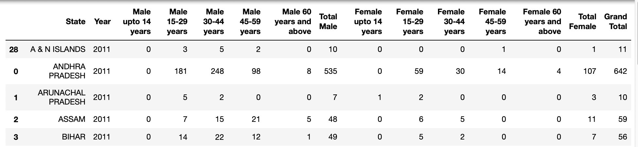
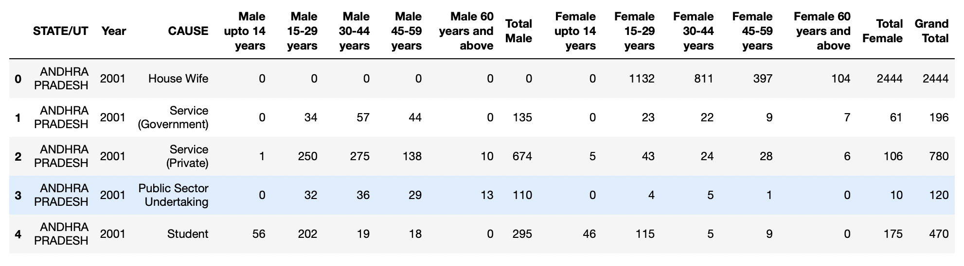
Data transformation –Educational profile of suicide victims data (contd.)
Fig. 18
After transformation
(35 X 15)
Before transformation (6300 X 16)
Fig. 17

Slide 33
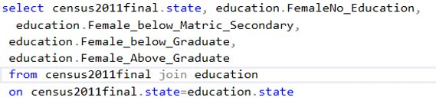
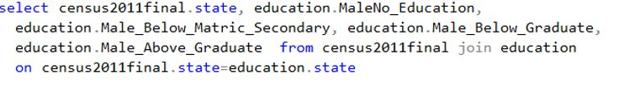
How are the numbers distributed among different educational categories ​?
The following query was used to get the data

Slide 34
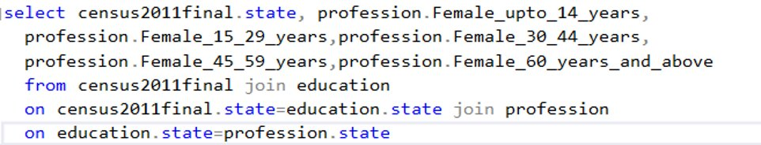
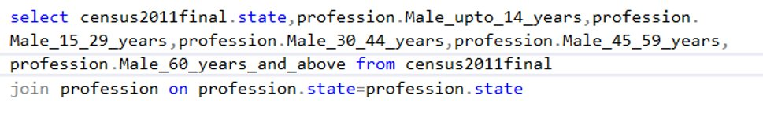
Distribution of suicide victims by their Age group
The below sql query gives the required data for our analysis

Slide 35
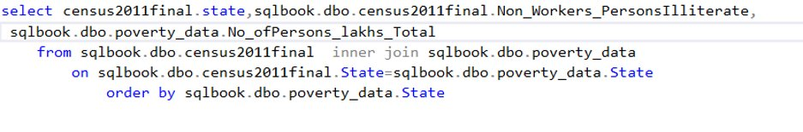
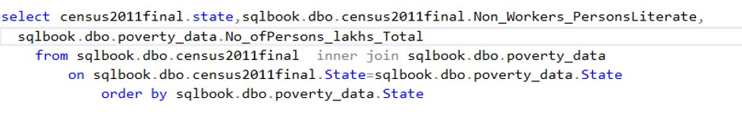
How does the count of Non workers relate to Poverty Line data

Slide 36
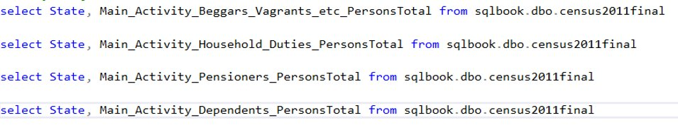
The counts of various activities of People for Different States

Slide 37
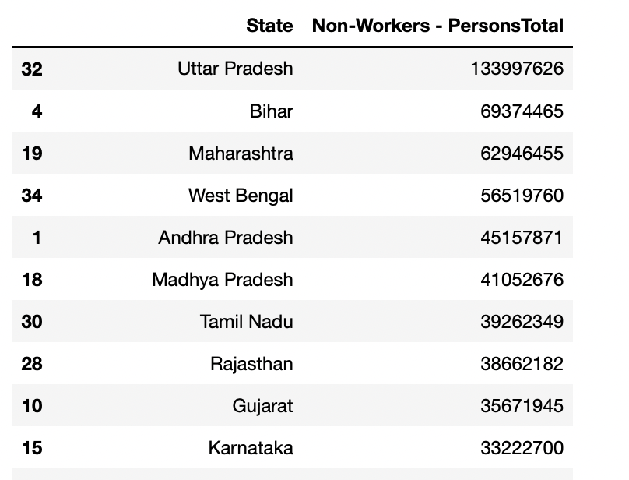
Answering the analysis questions – 1/4
The final merged dataset has been referenced for answering this question .
Every Indian region has their corresponding number of non-workers i.e. jobless/unemployed people classified by their gender and the educational category they belong to.
When the data was looked at region wise in the decreasing order of unemployment count, it revealed that – Indian state named “Uttar Pradesh” topped the list .
As per the data, the state is known to have 13,39,97,626 unemployed people as per the year 2011.
The snippet on the right shows the top 10 Indian regions as per their non-workers count and apparently Uttar Pradesh comes first.
Fig. 24

Slide 38
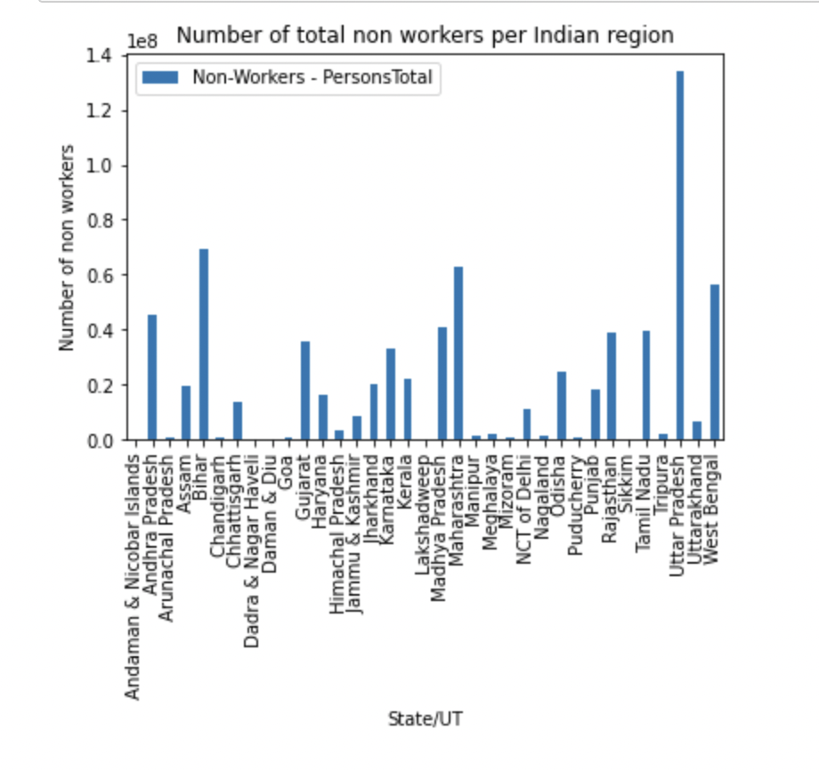
Total non-workers per Indian region
The bar plot given beside shows the unemployed people count per Indian region. Deciphering the graph, bigger the bar, more is the unemployment for the region and shorter the bar, lesser the joblessness .
Quite visibly, Uttar Pradesh has the highest bar among all the regions, backing up the number we derived from the data.
Fig. 25

Slide 39
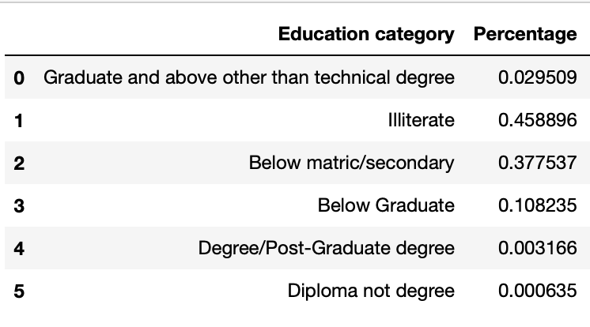
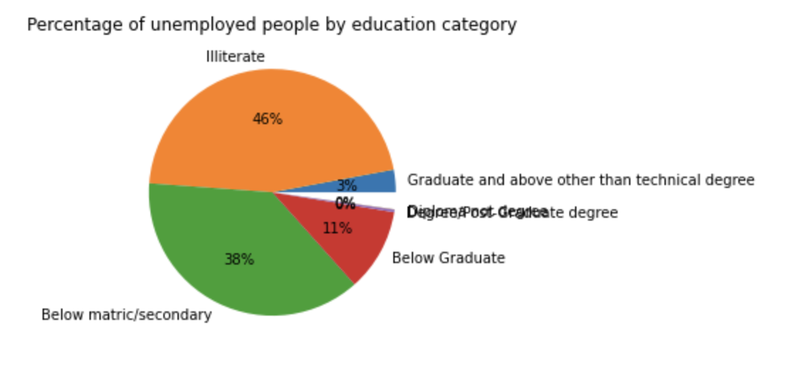
Unemployment percentage by education category
Moving on to the next part for finding out which education group constitutes the most unemployed people in Uttar Pradesh. Needless to mention, the non workers have been represented by different education categories.
Fig. 26
Fig. 27
The tabular data on the left represents percentage of unemployed people belonging to all education categories , the pie chart on the right depicts the same visually.

Slide 40
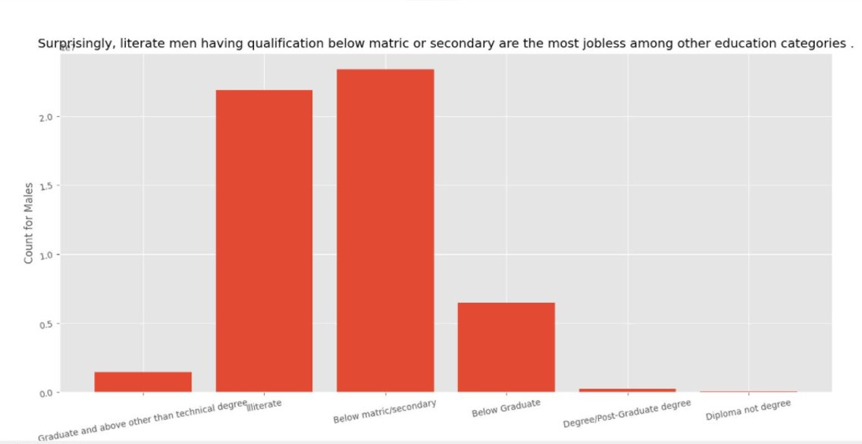
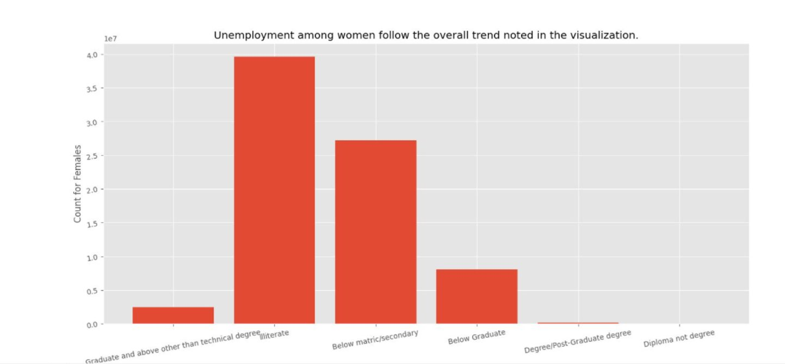
Unemployed men V/S women
MALES
V/S
FEMALES
Fig. 28
Fig. 29

Slide 41
Answering the analysis questions – 2/4
The primary objective of the question is to analyze suicide trend among unemployed people of India for the year 2011. The data has been classified as per the education and age group and the suicide numbers are available for both genders separately.
The question addresses all three different aspects of the problem.
Who is more prone to commit a suicide – Unemployed Men/Women ?
Which age group is the most suicidal ?
How do the stats look like for suicide victims by their education categories ?

Slide 42
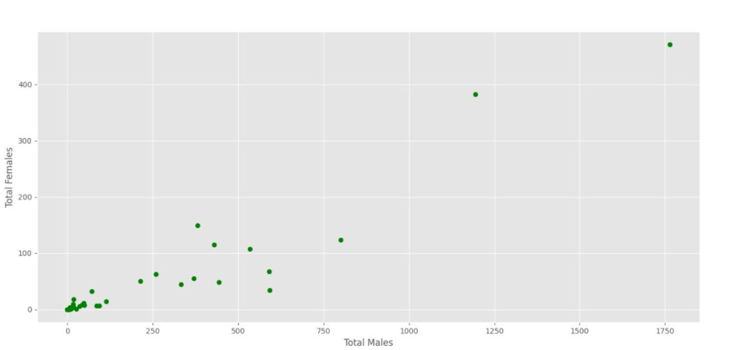
Male and female suicide victims
Fig. 30
Apparently, the suicide numbers seem to have a positive co-relation, Indian regions with less male suicide victims tend to have less female victims too and the other way around.

Slide 43
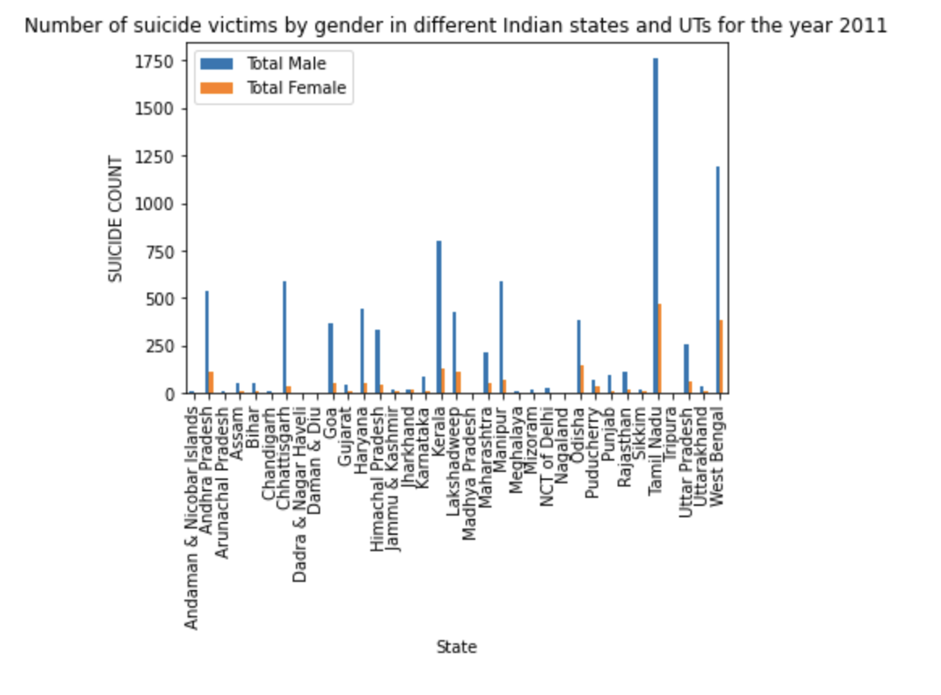
Gender wise suicide count for Indian regions
The plot makes comparison between the suicide count for both genders .
To conclude, in 31 out of 35 Indian regions, men committed more suicides than women.
Even for the rest of the regions, the suicide count for women was same as that of men.
So, men for sure were more suicidal than women back in 2011.
Fig. 31

Slide 44
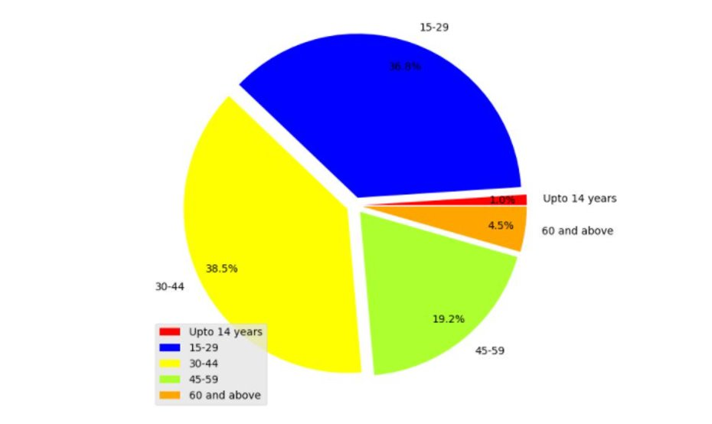
Suicide victims and their age groups
Next part of this analysis question was to understand suicide numbers for different age groups.
Quite evidently, unemployed Indians aged 30-44 committed the greatest number of suicides.
Fig. 60
Also, the difference for aged 30-44 and 15-29 is of barely 2% .

Slide 45
Answering the analysis questions – 3/4
The motive behind this question is to find the Number of people as a different categories who are contributing towards an unemployment state wise in India ?
To analysis this question we have chosen a histogram graph approach to show the numbers for different categories of people against states in India in subplots.

Slide 46
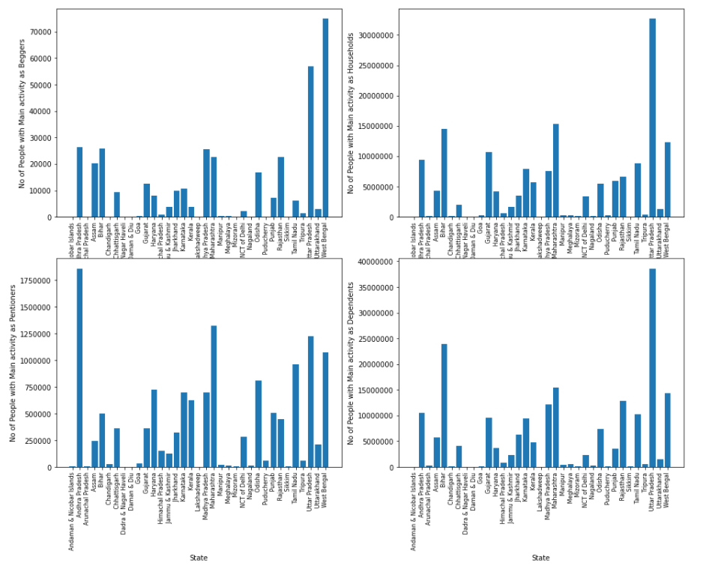
Non workers by category in different states
From the graph, we can observe that the states having the number of people in different categories with unemployment.
We can clearly see that from 1st subplot of 1st row, it is evident that the number of people with Main activity as Beggars are high in the state of West of Bengal with above 70k people.
Next, from 2nd subplot of 1st row, it is showing that the number of people with Main activity as Households are high in the state of Uttar Pradesh with above 30 million people.
Fig. 32

Slide 47
Non workers by category in different states (contd.)
Next, from 1st subplot of 2nd row, it is showing that the number of people with Main activity as Pensioners are high in the state of Andhra Pradesh with above 1.75 million people.
Lastly, from 2nd subplot of 2nd row, we can observe that the number of people with Main activity as Dependents are high in the state of Uttar Pradesh with just less than 40 million people.
Fig. 33

Slide 48
Answering the analysis questions – 4/4
The idea of this question is to find the relationship between the financial situation of people with the Unemployed people.
For solving this question we can come up with a scatter plot between the Total no of people below poverty line in all the states with the count of Non working people in respective states.
Here we are going to plot two different plots to see the relationship between both Non workers who are literate and Illiterate.

Slide 49
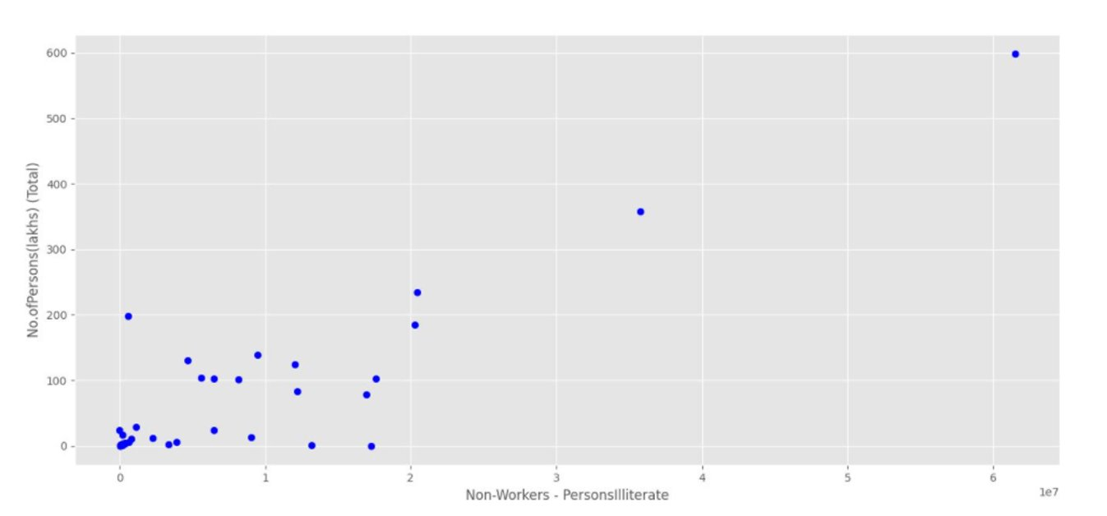
Non workers Illitierate Vs No of people below Poverty Line
The beside graph shows that there's a very high positive association between a states Non working illiterate people’s count and the No of people below poverty Line in it.
Calculating the Correlation Coefficient got a result of 0.881 which represents a strong relation.
With reference to the graph we can assume that higher Non working people in a state may be causing higher no of people below poverty line.
Fig. 34

Slide 50
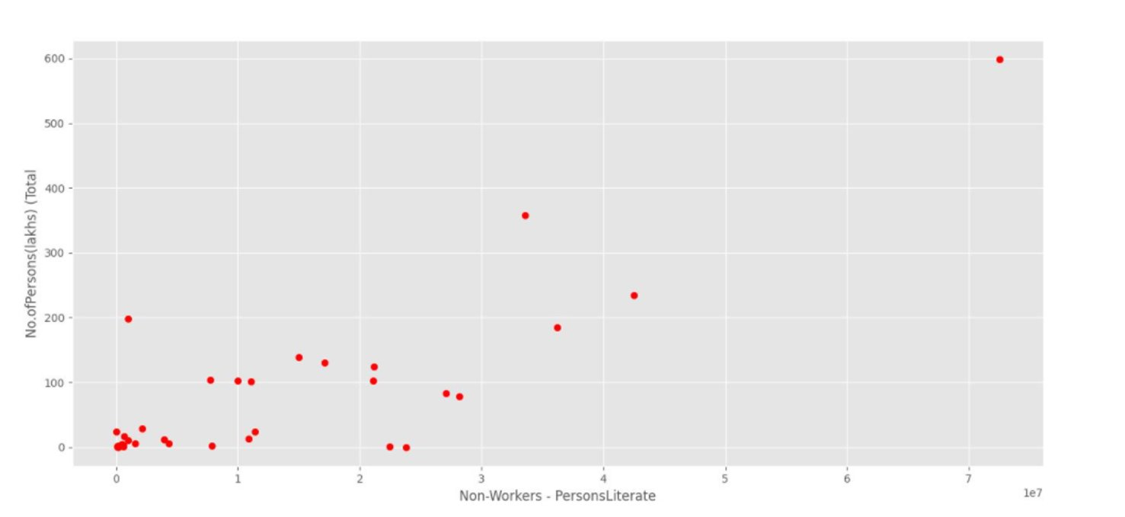
Answering the analysis questions – 4/4 (contd.)
Even the plot between the Illiterate Non workers and No of People below poverty line tend to have a high association with each other.
Even though there’s a small decrease in Poverty line count of people than the Illiterate non workers Poverty count, these both are sharing a strong relation.
It also depicts the same assumption of causing Higher in people below poverty line due to high no of Non workers in a state.
Fig. 35

Slide 51
Conclusion
Putting the findings obtained from analysis altogether, it can be concluded that Indian state Uttar Pradesh(U.P.) witnessed the worst unemployment in 2011 among all other regions. The count is not just the highest, it is way beyond what the picture looks like for other regions, to be specific the second highest unemployed state Bihar has half the number of non workers as U.P.
Further down the analysis, the data revealed that mostly the unemployed U.P. people hold no formal education at all i.e. they contribute greatly to the pool of unemployed people.
Further on, back in 2011 mental health of unemployed men was way terrible than that of women.
There might have been several different reasons that prompted people to end their own lives, but a part of the truth is that they were unemployed.
Adult men(30-44) suffered the most whereas young women aged 15-29 were the most terribly impacted .

Slide 52
Conclusion (contd.)
We concluded it from our analysis that the number of people of who are contributing to the unemployment are greatly high in households and dependents categories. However, the numbers are low for beggars and other categories, but they are some how sharing the numbers in unemployment rate.
We could also observe that even Pensioner's category (people would in their old age and retired) is also contributing to an extent portion of unemployment.
Though there are some states like Jharkhand where the count of Non working people is 19,889,860 they have very less population under poverty line which is 1.3 millions and this can be due to several factors like the aid provided by government may be sufficient for families to sustain their living or people having ancestral wealth which keeps them away from working.

Slide 53
Graphical User Interface Demo

